Slide 1





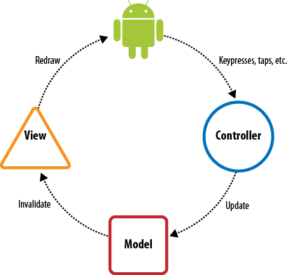


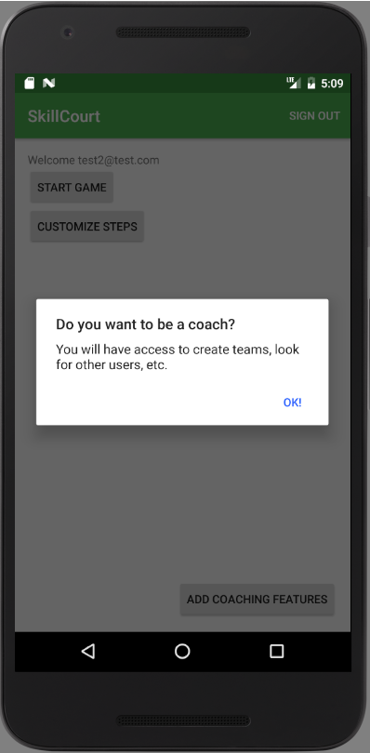
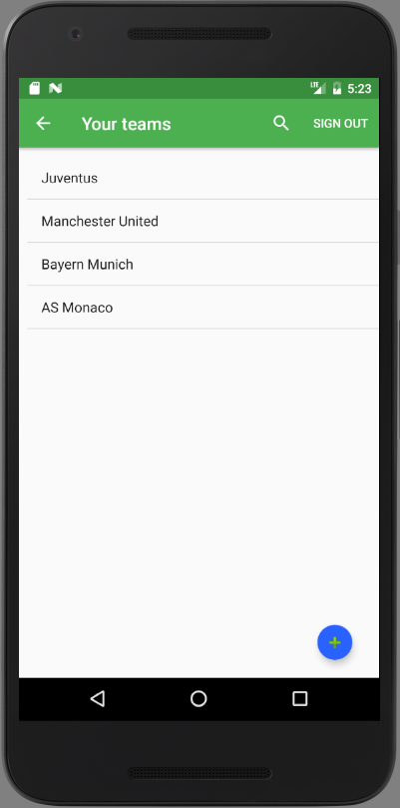
School of Computing & Information Sciences
Advanced Software Engineering, 2016, Fall
Skillcourt 6.0
Student: Jofran Peña Durán, Florida International University
Mentors: Mohsen Taheri, TA; Guðmundur Traustason, Product Owner
Instructor: Masoud Sadjadi, Florida International University
As time goes by we can see how technology is helping in our everyday life activities. But in sports sometimes we still rely on old practices to carry out with our team or individual trainings to improve our skills. In the case of soccer, when a player is trying to improve his passing accuracy and response time on first time passes there is no other option than group trainings.
Skillcourt 6.0 implements a new methodology to improve the aforementioned skill relying on a simple app and pads to train.
Problem & Solution
The current system requires a computer in order to activate the pads that the player is going to kick the balls against.
This is a little inconvenient; today mostly everyone has a smartphone in their pocket so implementing an app would be the best way to tackle this inconvenience.
Current System
As in any sport training methodology, someone to look up after you and challenge you to improve is needed.
Usually this person is a Coach. SkillCourt give players the chance to enroll as coach, create teams, add other user to this teams and then follow their progress.
This will keep players engaged getting feedback from a Coach that can suggest other routines based on the game history she/he can have access to.
Requirements
System Design
Object Design
Implementation
Android makes it easy to implement a Model-View-Controller system. This allows to include changes in the each layer affecting just to that one above it, the only layer aware of it.
The following is an instance of the sequence diagrams that can be found in the documentation:
Verification
Screenshots
Summary
Some of the test to verify the correct behavior of the app were:
Test Case 1
Purpose: Test that the Teams View is showing the teams saved in the database
Precondition: User is logged in and from the Main Coach Dashboard clicks on Coaching
Expected Result: When the aforementioned option is clicked the app goes to the Teams View that show a list of all the teams saved on the database.
Actual Result: Same as expected
Status: PASS
Test Case 2
Purpose: Test that a new team created is being saved in the database
Precondition: User is logged in and from the Main Coach Dashboard clicks on the plus button located in the bottom right corner, then fills out the form for a new team and clicks on the save button.
Expected Result: Once the save button is clicked, the app returns to the teams list view and shows the new team on the list.
Actual Result: Same as expected
Status: PASS
My major contribution were mainly on the conceptualization of the Coach role in the app. Along with the product owner and the team, the way this role was going to be approached was defined in consensus and implemented by me.
Player are able to enroll as Coach, create teams and give them a description, add players to this created teams and check the history of those players
Acknowledgement
The material presented in this poster is based upon the work supported by Jofran Peña Durán. I am thankful to the help that I received from my group members, April Perry, Rolando Ramos and Pedro Carrillo .
Notes:
1

